Slide 1
Impact of LR Annealing
On MRT 1 data

Slide 2
LR Annealing
Starts with learning rate 0.001
Uses optim.lr_scheduler.ReduceLROnPlateau(self.optimizer)
If early stopping is used, it considers the impact of the reduced learning rate → training might stop earlier still:
Stopping condition: validation_loss > (self.min_validation_loss + self.min_delta*learning_rate*1e3) happens several times

Slide 3
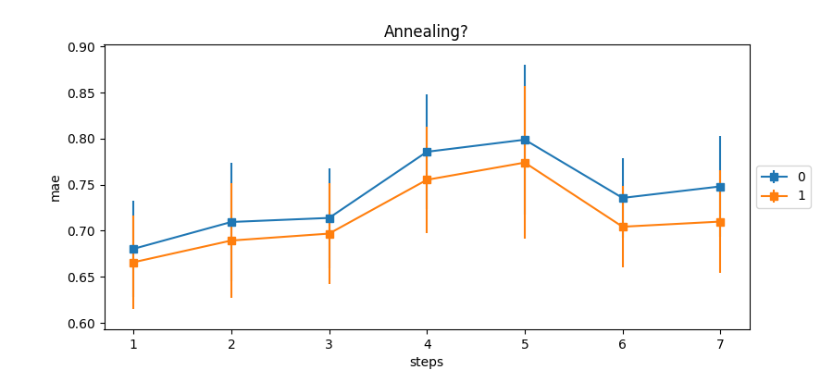
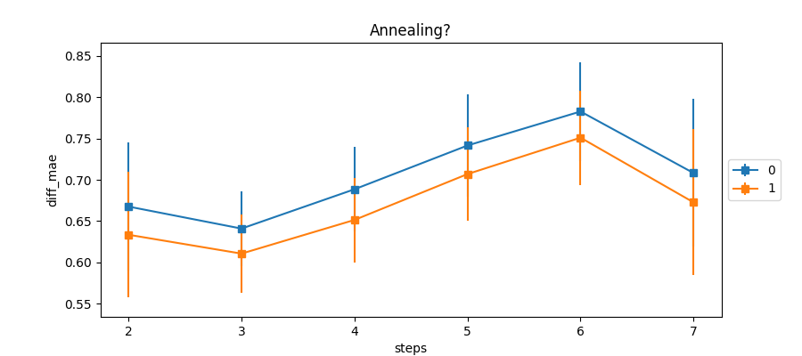
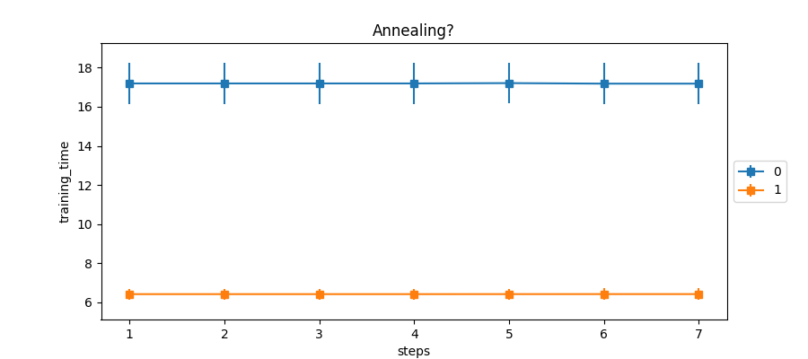
Using best runs

Slide 4
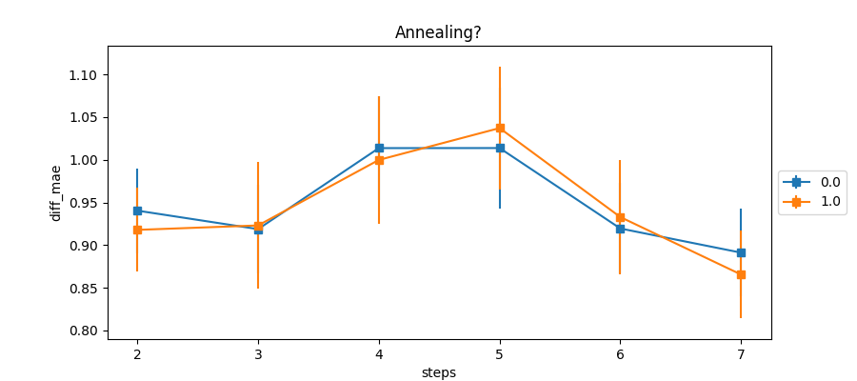
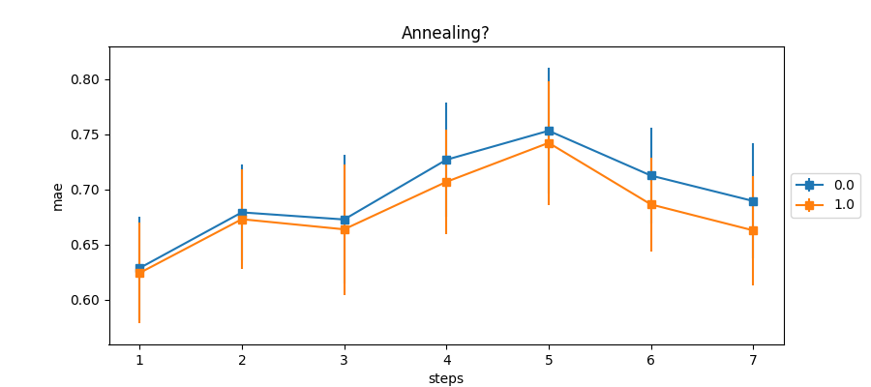
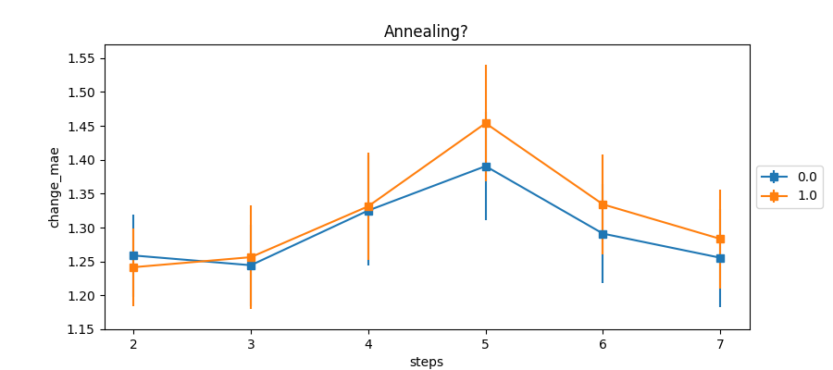
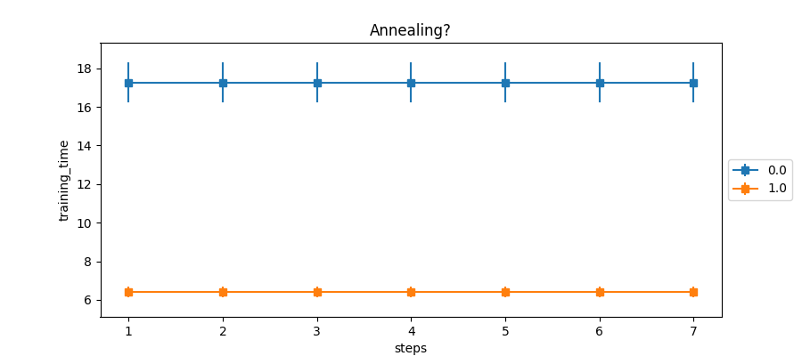
Using ensemble predictors

Slide 5
Bottom line
LR annealing is beneficial when using best runs
LR annealing is not harmful when using ensemble predictors
LR annealing speeds up training 2.5x

